Slide 1
Chapter 20:
Recursion

Slide 2
Introduction to Recursion
A recursive function contains a call to itself:
  void countDown(int num)
  {
  if (num == 0)
  cout << "Blastoff!";
  else
  {
  cout << num << "...\n";
  countDown(num-1); // recursive
  } // call
  }

Slide 3
What Happens When Called?
If a program contains a line like countDown(2);
countDown(2) generates the output 2..., then it calls countDown(1)
countDown(1) generates the output 1..., then it calls countDown(0)
countDown(0) generates the output Blastoff!, then returns to countDown(1)
countDown(1) returns to countDown(2)
countDown(2)returns to the calling function

Slide 4
What Happens When Called?
first call to
countDown
num is 2
output:
2...
countDown(1);
second call to
countDown
num is 1
1...
countDown(0);
third call to
countDown
num is 0
Blastoff!
// no
// recursive
// call

Slide 5
20.2
Solving Problems with Recursion

Slide 6
Recursive Functions - Purpose
Recursive functions are used to reduce a complex problem to a simpler-to-solve problem.
The simpler-to-solve problem is known as the base case
Recursive calls stop when the base case is reached

Slide 7
Stopping the Recursion
A recursive function must always include a test to determine if another recursive call should be made, or if the recursion should stop with this call
In the sample program, the test is:
if (num == 0)

Slide 8
Stopping the Recursion
  void countDown(int num)
  {
  if (num == 0) // test
  cout << "Blastoff!";
  else
  {
  cout << num << "...\n";
  countDown(num-1); // recursive
  } // call
  }

Slide 9
Stopping the Recursion
Recursion uses a process of breaking a problem down into smaller problems until the problem can be solved
In the countDown function, a different value is passed to the function each time it is called
Eventually, the parameter reaches the value in the test, and the recursion stops

Slide 10
Stopping the Recursion
  void countDown(int num)
  {
  if (num == 0)
  cout << "Blastoff!";
  else
  {
  cout << num << "...\n";
  countDown(num-1);// note that the value
  } // passed to recursive
  } // calls decreases by
  // one for each call

Slide 11
What Happens When Called?
Each time a recursive function is called, a new copy of the function runs, with new instances of parameters and local variables created
As each copy finishes executing, it returns to the copy of the function that called it
When the initial copy finishes executing, it returns to the part of the program that made the initial call to the function

Slide 12
What Happens When Called?
first call to
countDown
num is 2
output:
2...
countDown(1);
second call to
countDown
num is 1
return
1...
countDown(0);
third call to
countDown
num is 0
return
Blastoff!
// no
// recursive
// call
return

Slide 13
Types of Recursion
Direct
  a function calls itself
Indirect
  function A calls function B, and function B calls function A
  function A calls function B, which calls …, which calls function A

Slide 14
The Recursive Factorial Function
The factorial function:
  n! = n*(n-1)*(n-2)*...*3*2*1 if n > 0
  n! = 1 if n = 0
Can compute factorial of n if the factorial of (n-1) is known:
  n! = n * (n-1)!
n = 0 is the base case

Slide 15
The Recursive Factorial Function
  int factorial (int num)
  {
  if (num > 0)
  return num * factorial(num - 1);
  else
  return 1;
  }

Slide 16
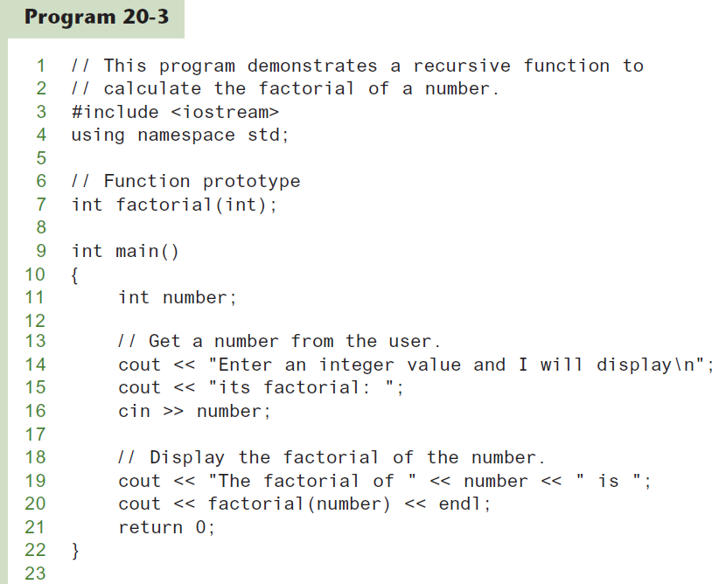


Slide 17
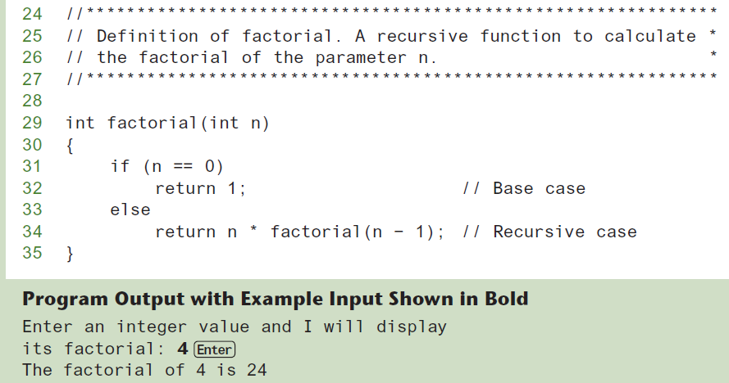
Program 20-3 (Continued)

Slide 18
20.3
The Recursive gcd Function

Slide 19
The Recursive gcd Function
Greatest common divisor (gcd) is the largest factor that two integers have in common
Computed using Euclid's algorithm:
  gcd(x, y) = y if y divides x evenly
  gcd(x, y) = gcd(y, x % y) otherwise
gcd(x, y) = y is the base case

Slide 20
The Recursive gcd Function
  int gcd(int x, int y)
  {
  if (x % y == 0)
  return y;
  else
  return gcd(y, x % y);
  }

Slide 21
20.4
Solving Recursively Defined Problems

Slide 22
Solving Recursively Defined
Problems
The natural definition of some problems leads to a recursive solution
Example: Fibonacci numbers:
  0, 1, 1, 2, 3, 5, 8, 13, 21, ...
After the starting 0, 1, each number is the sum of the two preceding numbers
Recursive solution:
  fib(n) = fib(n – 1) + fib(n – 2);
Base cases: n <= 0, n == 1

Slide 23
Solving Recursively Defined Problems
  int fib(int n)
  {
  if (n <= 0)
  return 0;
  else if (n == 1)
  return 1;
  else
  return fib(n – 1) + fib(n – 2);
  }

Slide 24
20.5
Recursive Linked List Operations

Slide 25
Recursive Linked List Operations
Recursive functions can be members of a linked list class
Some applications:
  Compute the size of (number of nodes in) a list
  Traverse the list in reverse order

Slide 26
Counting the Nodes in a Linked List
Uses a pointer to visit each node
Algorithm:
  pointer starts at head of list
  If pointer is null pointer, return 0 (base case)
  else, return 1 + number of nodes in the list pointed to by current node
See the NumberList class in Chapter 19

Slide 27
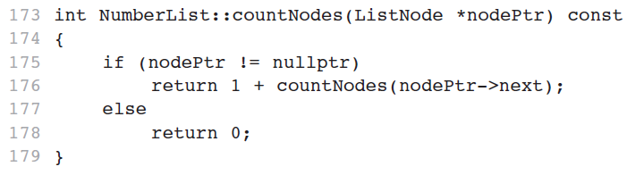
The countNodes function, a private member function
The countNodes function is executed by the public numNodes function:
int numNodes() const
{ return countNodes(head); }

Slide 28
Contents of a List in Reverse Order
Algorithm:
  pointer starts at head of list
  If the pointer is null pointer, return (base case)
  If the pointer is not null pointer, advance to next node
  Upon returning from recursive call, display contents of current node

Slide 29
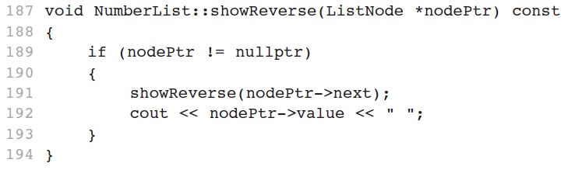
The showReverse function, a private member function
The showReverse function is executed by the public displayBackwards function:
void displayBackwards() const
{ showReverse(head); }

Slide 30
20.6
A Recursive Binary Search Function

Slide 31
A Recursive Binary Search Function
Binary search algorithm can easily be written to use recursion
Base cases: desired value is found, or no more array elements to search
Algorithm (array in ascending order):
  If middle element of array segment is desired value, then done
  Else, if the middle element is too large, repeat binary search in first half of array segment
  Else, if the middle element is too small, repeat binary search on the second half of array segment

Slide 32
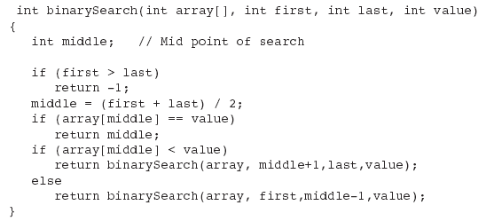
A Recursive Binary Search Function (Continued)

Slide 33
20.7
The Towers of Hanoi

Slide 34
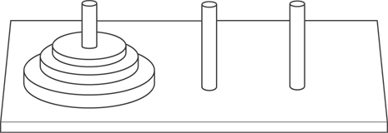
The Towers of Hanoi
The Towers of Hanoi is a mathematical game that is often used to demonstrate the power of recursion.
The game uses three pegs and a set of discs, stacked on one of the pegs.

Slide 35
The Towers of Hanoi
The object of the game is to move the discs from the first peg to the third peg. Here are the rules:
  Only one disc may be moved at a time.
  A disc cannot be placed on top of a smaller disc.
  All discs must be stored on a peg except while being moved.

Slide 36
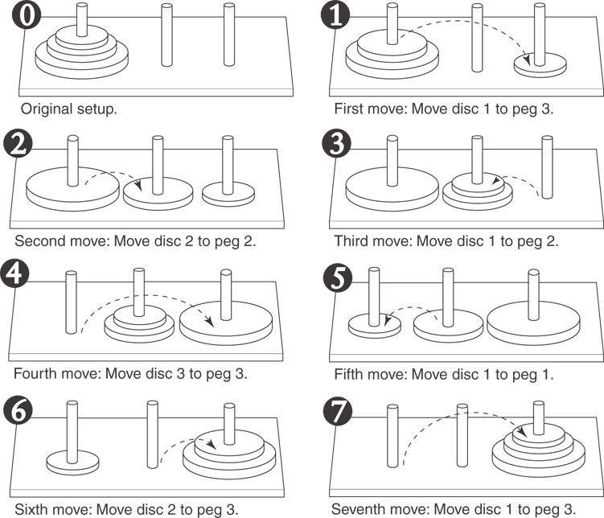
Moving Three Discs

Slide 37
The Towers of Hanoi
The following statement describes the overall solution to the problem:
  Move n discs from peg 1 to peg 3 using peg 2 as a temporary peg.

Slide 38
The Towers of Hanoi
Algorithm
  To move n discs from peg A to peg C, using peg B as a temporary peg:
  If n > 0 Then
  Move n – 1 discs from peg A to peg B, using
  peg C as a temporary peg.
  Move the remaining disc from the peg A to peg C.
  Move n – 1 discs from peg B to peg C, using
  peg A as a temporary peg.
  End If

Slide 39
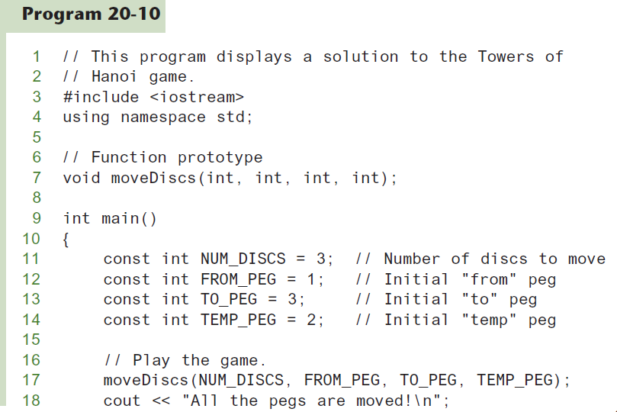

Slide 40
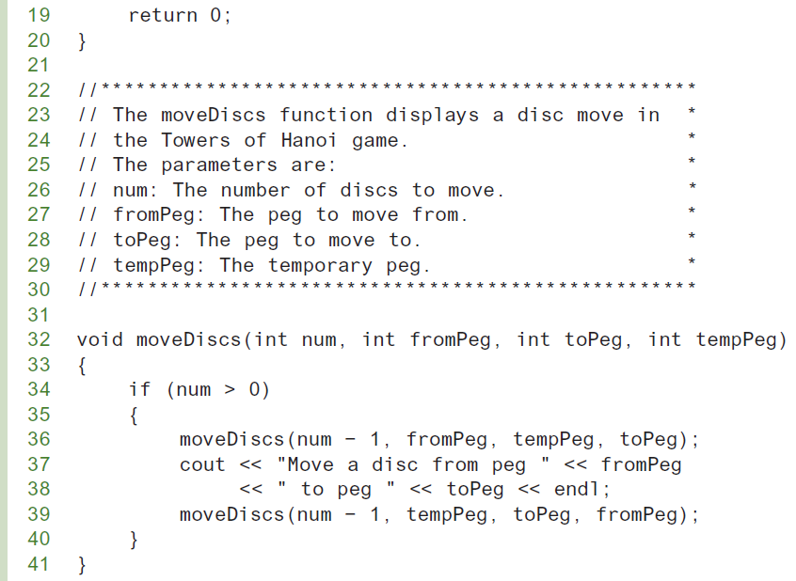

Slide 41
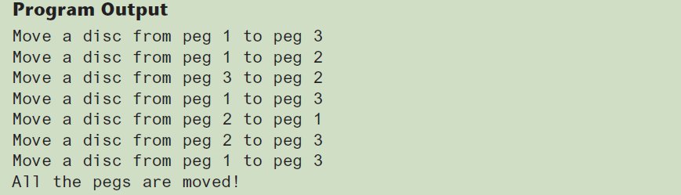
Program 20-10 (Continued)

Slide 42
20.8
The QuickSort Algorithm

Slide 43
The QuickSort Algorithm
Recursive algorithm that can sort an array or a linear linked list
Determines an element/node to use as pivot value:
pivot
sublist 1
sublist 2

Slide 44
The QuickSort Algorithm
pivot value
sublist 1
sublist 2
Once pivot value is determined, values are shifted so that elements in sublist1 are < pivot and elements in sublist2 are > pivot
Algorithm then sorts sublist1 and sublist2
Base case: sublist has size 1

Slide 45
20.9
Exhaustive and Enumeration Algorithms

Slide 46
Exhaustive and Enumeration Algorithms
Exhaustive algorithm: search a set of combinations to find an optimal one
  Example: change for a certain amount of money that uses the fewest coins
Uses the generation of all possible combinations when determining the optimal one.

Slide 47
20.10
Recursion and Variadic Function Templates

Slide 48
Variadic Function Templates
A variadic function template is a template for a function that takes a variable number of arguments
Example: Suppose we want to write an add function that takes any number of arguments and returns the sum of those arguments:
// The following displays 3
cout << add(1, 2) << endl;
// The following displays 10
cout << add(1, 2, 3, 4) << endl;

Slide 49
Variadic Function Templates
To write the variadic add function, we will write two function templates:
  one for an add function that handles the base case (when there is only one argument left in the argument list)
  another for an overloaded add function that handles the recursive case (when there is more than one argument left in the argument list)

Slide 50
Variadic Function Templates
Code for the add function that handles the base case:
template <typename T>
T add(T n)
{
return n;
}

Slide 51
Variadic Function Templates
Code for the overloaded add function that handles the recursive case:
Generic type T
Template Parameter Pack
template<typename T, typename... TypeArgs>
T add(T firstArg, TypeArgs... remainingArgs)
{
return firstArg + add(remainingArgs...);
}
Function Parameter Pack

Slide 52
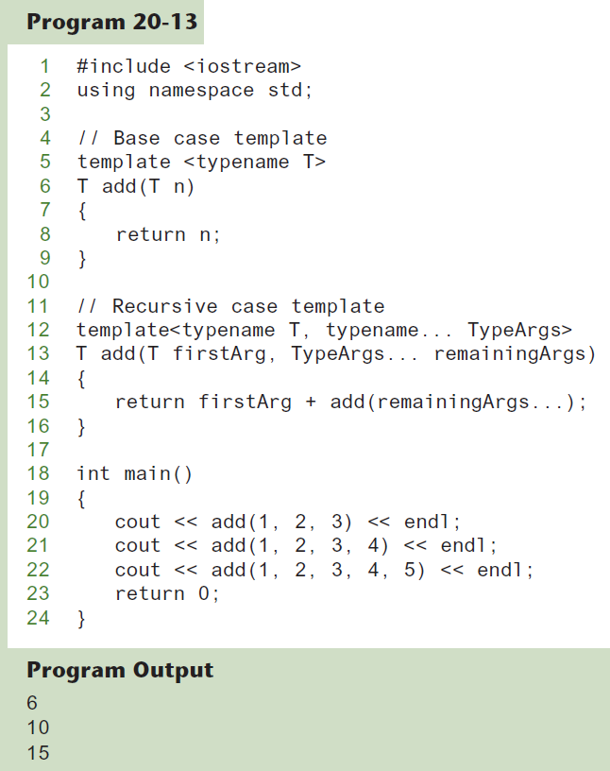

Slide 53
20.11
Recursion vs. Iteration

Slide 54
Recursion vs. Iteration
Benefits (+), disadvantages(-) for recursion:
  Models certain algorithms most accurately
  Results in shorter, simpler functions
  May not execute very efficiently
Benefits (+), disadvantages(-) for iteration:
  Executes more efficiently than recursion
  Often is harder to code or understand

